Slide 1
BRITISH AIRWAYS CSAT
BRITISH AIRWAYS CUSTOMER SATISFACTION (CSAT) ANALYSIS DASHBOARD
Tools Used:
POWER BI
DAX
POWER QUERY
EXCEL/CSV
PROJECT OVERVIEW:
The objective of this project is to analyze customer reviews of British Airways to understand customer satisfaction, identify factors affecting passenger experience, and provide insights that can help improve airline services.

Slide 2
BUSINESS PROBLEM:
Understand customer satisfaction levels.
Identify high-performing and low-performing services.
Analyze recommendations by passengers.
Compare customer experience across traveller types, seat classes, locations, and time.
DATASET INFORMATION:
DATASET SOURCE : British Airways Customer Reviews Dataset
Number of Reviews: 1325
Tables Used : ba_reviews , countries , Date Table
Important Columns : Rating , Recommendation ,Seat Type , Traveller Type , Aircraft , Country , Date , Entertainment , Food & Beverages , Seat Comfort , Ground Service ,
Cabin Staff Service , Value for Money

Slide 3
Data Preparation :
Data Cleaning :
Removed unnecessary columns
Converted data types
Created relationships
Created Date Table
Built DAX Measures
Checked missing values
Relationships :
Countries → ba_reviews
Date Table → ba_reviews

Slide 4
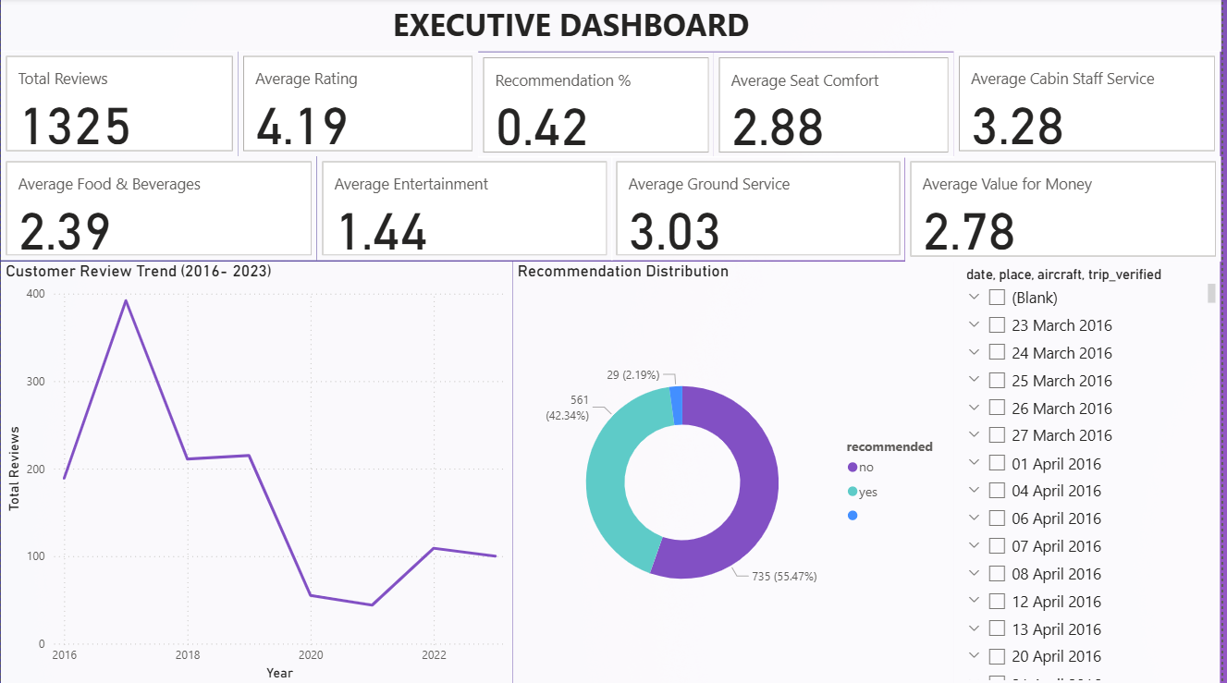
Dashboard Pages :
Executive Dashboard :

Slide 5
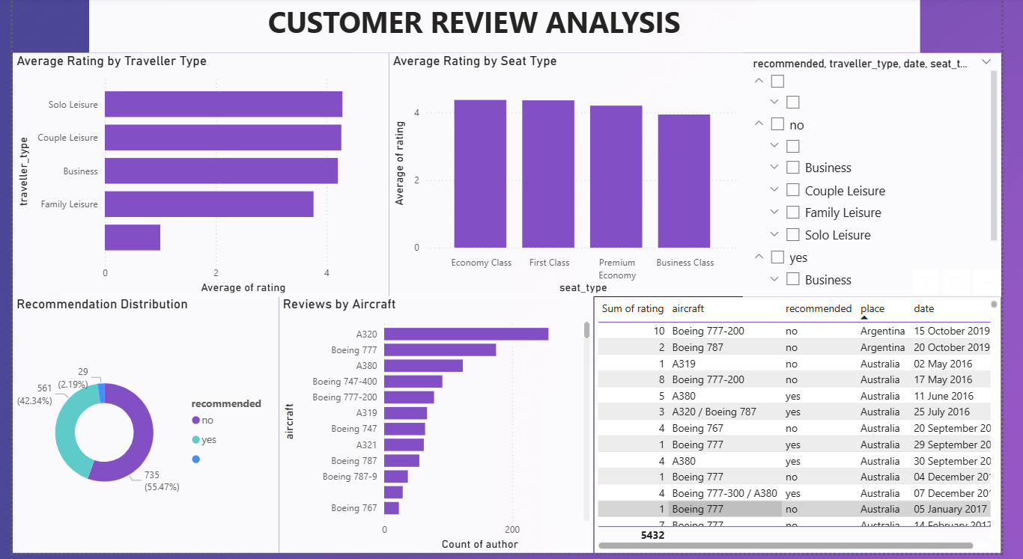
Customer Review Analysis :
Traveler and seat analysis

Slide 6
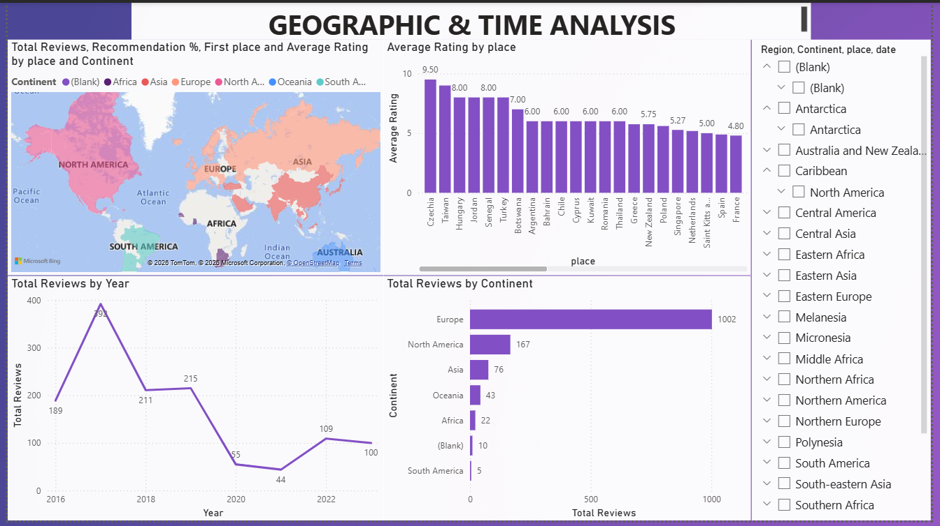
Geographic & Time Analysis :
Country-wise & yearly trends

Slide 7
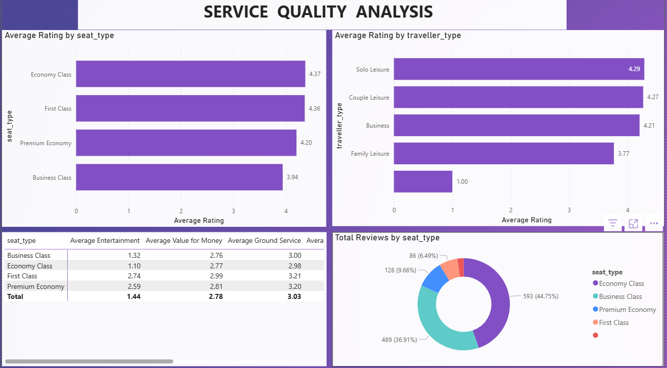
Service Quality Analysis :
Comparison of service ratings

Slide 8
Executive Dashboard Insights :
Key Metrices :
Total Reviews: 1,325
Average Overall Rating: 4.19/10
Recommendation Rate: 42%
Average Cabin Staff Service: 3.28
Average Ground Service: 3.03
Average Seat Comfort: 2.88
Average Value for Money: 2.78
Average Food & Beverages: 2.39
Average Entertainment: 1.44
Insights :
Less than half of customers recommend British Airways.
Cabin Staff Service is the highest-rated service.
Entertainment is the lowest-rated aspect, indicating a major improvement area.
Food & Beverages and Value for Money also receive relatively low ratings.
Overall customer satisfaction is moderate rather than excellent.

Slide 9
Customer Review Analysis Insights :
Solo Leisure passengers gave the highest average ratings.
Family Leisure travelers were comparatively less satisfied.
First Class passengers reported higher satisfaction than Business Class passengers.
Premium Economy performed better than Economy in several service categories.
Most reviews were marked as "Not Recommended," highlighting opportunities to improve customer experience.
Airbus A320 and Boeing 777 aircraft received the largest number of reviews.
Geographic & Time Analysis Insight :
Europe generated the highest number of customer reviews.
Asia and North America contributed a moderate number of reviews.
Africa and South America had relatively few reviews.
Customer reviews peaked around 2017 and declined in later years.
Average ratings vary significantly by country, showing differences in customer experience across regions.

Slide 10
Service Quality Analysis Insights :
First Class achieved the highest average rating.
Business Class scored slightly lower than expected, suggesting room for improvement.
Ground Service and Cabin Staff Service consistently received good ratings.
Entertainment, Food & Beverages, and Value for Money remained the weakest service categories across all seat types.
Premium passengers generally reported better experiences than Economy passengers.
Recommendations :
Improve the onboard entertainment system.
Enhance food quality and beverage options.
Increase value for money through better service offerings.
Investigate why Family Leisure travellers are less satisfied.
Replicate the best practices of Cabin Staff across other service areas.
Focus on improving customer satisfaction in lower-rated regions.

Slide 11
Final Conclusion :
This dashboard helped to identify ;
Overall customer satisfaction level.
Service areas needing immediate attention.
Performance differences across traveller types and seat classes.
Geographic trends in customer satisfaction.
Yearly changes in review patterns.
Business Impact :
The dashboard enables management to quickly identify weak service areas, monitor customer satisfaction, and prioritize improvements using data-driven insights.
Thank You

